Slide 1
Wayward Navigation Rover
Austin Booth, Jacob Freeman, Andre Mbakwe, Garrett Shoemaker, Wesley Dodgen, Aaron Hoffman
Notes:
RECORD MEETING!

Slide 2
Introduction
-GT Engineering group tasked to create a mobile robot platform to navigate through a garden
-Goal is to navigate robot remotely via cloud and mobile device
-Design will be open source when completed
-Possible issues: sustainable power, space for GNC module and space for additional components, robot tracking from remote location
-Possible Solution: solar panel charger, ensure robot is large enough for components
Notes:
Fill out google form sent out earlier today!

Slide 3
Customer Requirements/Design Goals
Customer: Modern Radio/ Hip-Sci, perspective customers
Customer Requirements:
Rechargeable battery*
Long battery life*
Traverse obstacles*
Space for Future accessories
Ability to view various size plant rows and beds
Operate entirely outdoors
Notes:
4. Our tools will be marked so hopefully it will prevent students from taking them home. Also, we will have cameras pointed at the tool area to ensure no tools are stolen. We do have cameras all around the lab, so if any incidents happen, we can go to GTPD.
Constantly remind students to put things back where they found them!

Slide 4
Customer Requirements continued...
Integrate GNC (Guidance, Navigation, Control) modem*
Rover control with cell phone
Wireless connectivity to rover and cloud
Software system able to integrate additional sensors*
Simplistic design for easy repairs and operation
Notes:
4. Our tools will be marked so hopefully it will prevent students from taking them home. Also, we will have cameras pointed at the tool area to ensure no tools are stolen. We do have cameras all around the lab, so if any incidents happen, we can go to GTPD.
Constantly remind students to put things back where they found them!

Slide 5
Technical Specifications & HOQ
Electrical:
12 hr + battery life*
Solar Panel charger(2A charge rate)*
Brushed motor for rover movement(target 3mph)
Mechanical:
Ability to traverse difficult terrain*
Weatherproof(Heat, Cold, Rain, Acts of God)
Simple design and construction(repairable by user)

Slide 6
Technical Specifications & HOQ
Software:
Integration of GNC modem*
Communication with cloud service for position, remote viewing and control
UI and control with mobile app*
General:
Integrate future accessories after release*
User friendly controls and easy operation
Weight: target of 150 lbs(includes payload)

Slide 7
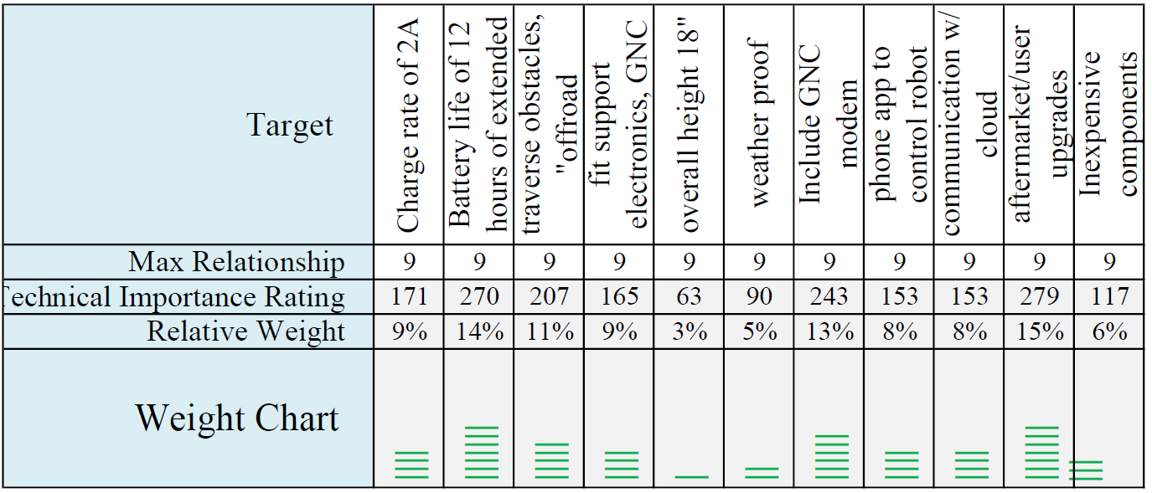
HOQ Weight Chart

Slide 8
Design Concept Ideation
System controller:
Raspberry Pi
UI and Control with mobile app:
Modern Radio GNC-Modem
High-resolution Wi-Fi camera
Robot Analytic features:
Modern Radio IOT stick
Modern Radio Sensors
Robot Build major factors:
• Durability
• Size
• Water-resistant
Notes:
4. Our tools will be marked so hopefully it will prevent students from taking them home. Also, we will have cameras pointed at the tool area to ensure no tools are stolen. We do have cameras all around the lab, so if any incidents happen, we can go to GTPD.
Constantly remind students to put things back where they found them!

Slide 9
Preliminary Concept Selection
There are seven finalized design aspects: modular robot chassis, raspberry pi, JPL open API, controlled over cellular, recharged to solar panels, wifi enabled camera, modern radio sensor.
We are responsible for :
The rechargeable battery pack : Panasonic 18650
The motors: DC brushed motors
The motor controllers: Generic DC motor controller
Software and hardware that controls and operates the robot.
Potential Risks:
Low output motors.
Short battery life.

Slide 10
Engineering Analyses
There will be many amounts of inspection tests and evaluations once specification requirements have been defined.
Prototype testing stages:
Manual Control of the Robot with HW Interface
Cellular Device Control of the Robot
Manual Control of the Robot with HW Interface:
Movement testing using a gaming controller.
Movement on various terrain types
Cellular Device Control of the Robot:
Movement testing using cellular device.
Data translation from several sensor inputs.

Slide 11
Codes and Standards
A list of several standards that will affect the design decisions of this project include:
UL 1642 – Standard for Safety for Lithium Batteries
ANSI/NEMA C18 – Safety Standards for Primary, Secondary and Lithium Batteries
UL 2054 – Standard for Household and Commercial Batteries
UL1004: Establishes general requirements for all types of electrical motors
1641 - IEEE Standard for Signal and Test Definition

Slide 12
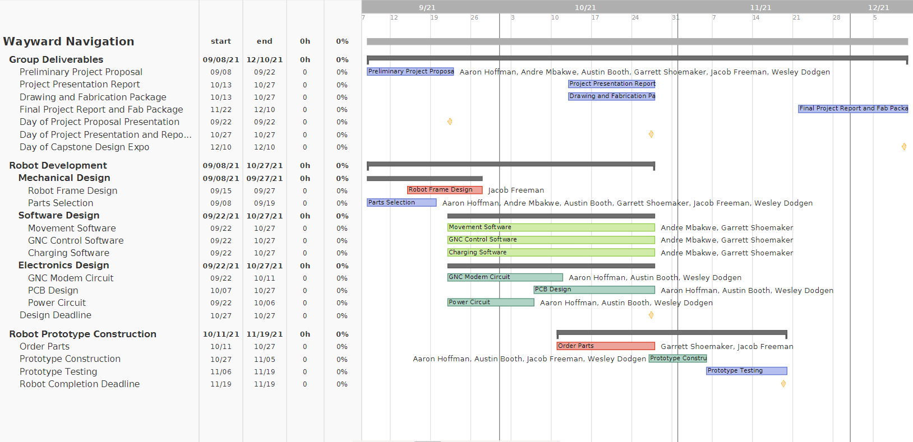
Team Schedule Gantt Chart

Slide 13
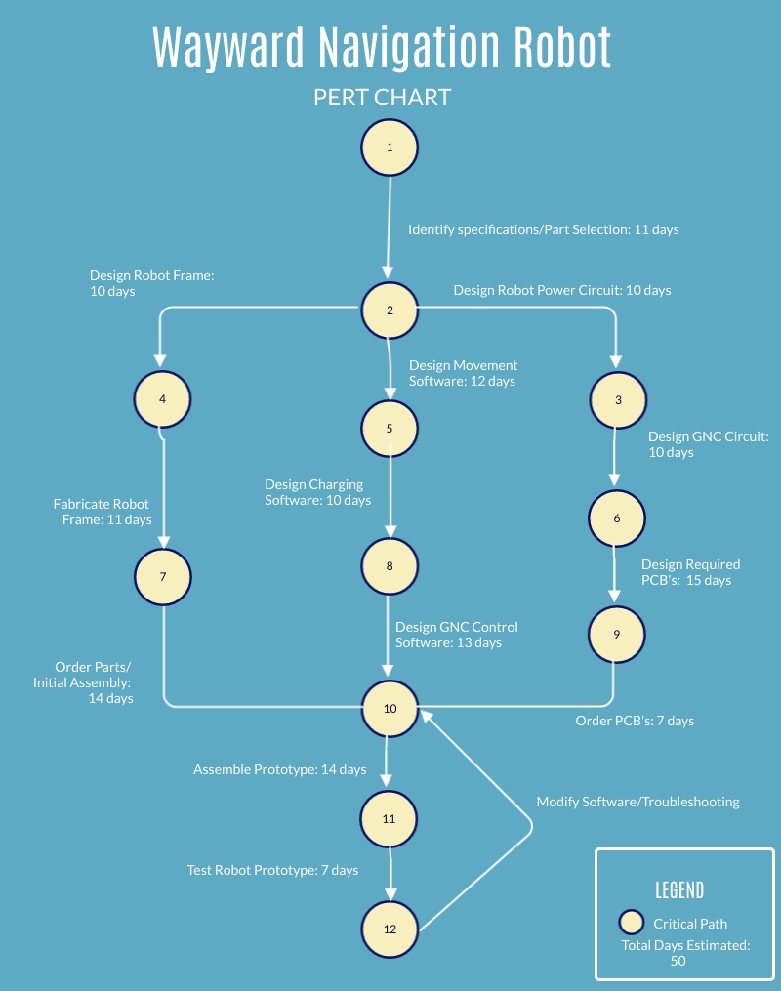
Critical Path PERT Chart
Estimated chance of success: 95%
Minimum days for completion: 50
Margin of 10 days
Error margin attributed to issues that may be encountered during robot assembly, testing, and troubleshooting

Slide 14
Marketing Analysis
Competitor
Features
Collision Sensor
Real-Time Video Transmission
Control Via Mobile Application
Price
$72.24 - $138.99
GT Robot
Features
Weather Resistant
Near Limitless Range (GNC-Modem)
Self-Charging Via Solar Panel
Price
$0.00

Slide 15
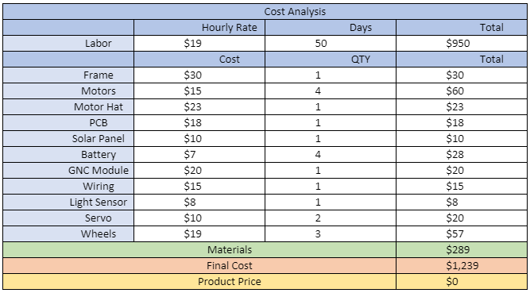
Cost Analysis

